Slide 1

Topic: Scheduling Policies
Lecture: Dr. Zhao Jie
Date: 02/09/2025

Slide 2
Reading Assignment
Reading Assignment: Ch. 7 & 8

Slide 3
Agenda
Definition of scheduling policies
FIFO
SJF
STCF
RR

Slide 4
Motivation of scheduling policies
In a scenario where multiple processes are in the ready state and wait for the CPU resource to run, the OS will make a strategy to decide which process to run first, which process to run next, and which process to run last.
In the strategy, there are the following factors that need to be considered:
Is the process exemptive? (This means that the process won’t be interrupted until its complement.)
If the processes are cooperative, how long is each process allocated to use the CPU resource?

Slide 5
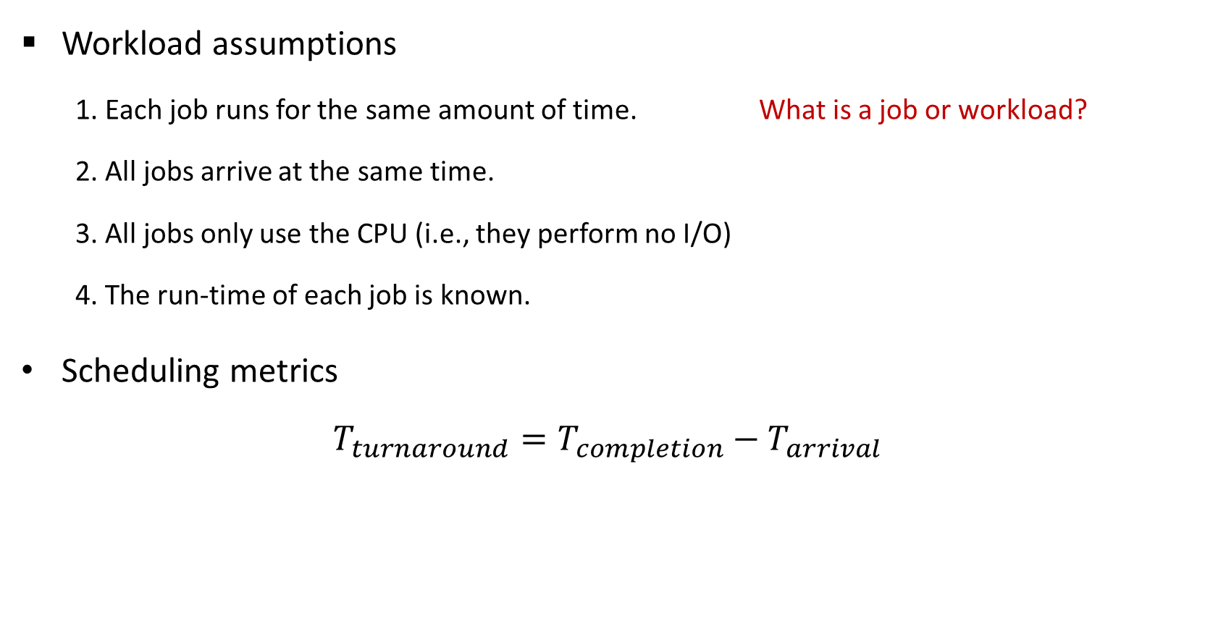
Working load assumptions
Workload assumptions
1. Each job runs for the same amount of time. What is a job or workload?
2. All jobs arrive at the same time.
3. All jobs only use the CPU (i.e., they perform no I/O)
4. The run-time of each job is known.
Scheduling metrics
$$T_{turnaround}=T_{completion}−T_{arrival}$$
$$T_{response}=T_{firstrun}−T_{arrival}$$
Notes:
Job or working load: The processes running in the systems.

Slide 6
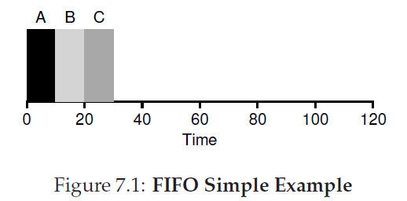
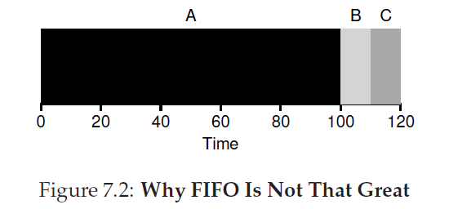
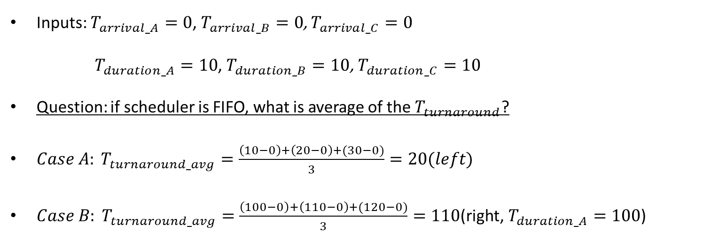
First- In- First – Out (FIFO)
Inputs: $T_{arrival_A}=0$, $T_{arrival_B}=0$, $T_{arrival_C}=0$
$T_{duration_A}=10$, $T_{duration_B}=10$, $T_{duration_C}=10$
Question: if scheduler is FIFO, what is average of the $T_{turnaround}$?
${Case A: T}_{turnaround_avg}=\frac{\left(10−0\right)+\left(20−0\right)+(30−0)}{3}=20(left)$
$Case B: T_{turnaround_avg}=\frac{\left(100−0\right)+\left(110−0\right)+(120−0)}{3}=110\text{(}\text{right}\text{, }T_{duration_A}=10\text{0}\text{)}$
Case A
Case B

Slide 7
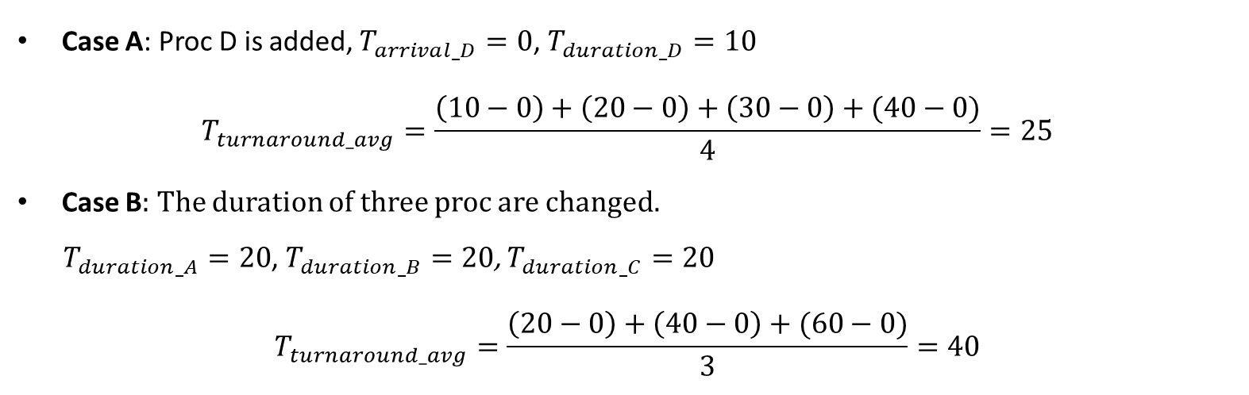
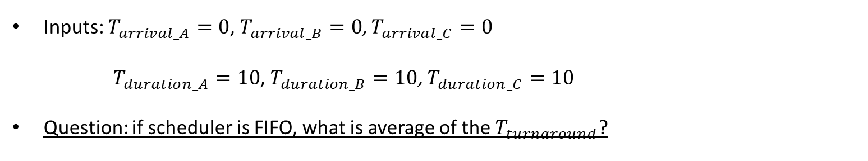
Practice: First- In- First – Out (FIFO)
Inputs: $T_{arrival_A}=0$, $T_{arrival_B}=0$, $T_{arrival_C}=0$
$T_{duration_A}=10$, $T_{duration_B}=10$, $T_{duration_C}=10$
Question: if scheduler is FIFO, what is average of the $T_{turnaround}$?
Case A: Proc D is added, $T_{arrival_D}=0$, $T_{duration_D}=10$
$$T_{turnaround_avg}=\frac{\left(10−0\right)+\left(20−0\right)+\left(30−0\right)+(40−0)}{4}=25$$
Case B: The duration of three proc are changed.
$T_{duration_A}=20$, $T_{duration_B}=20$, $T_{duration_C}=20$
$$T_{turnaround_avg}=\frac{\left(20−0\right)+\left(40−0\right)+(60−0)}{3}=40$$

Slide 8
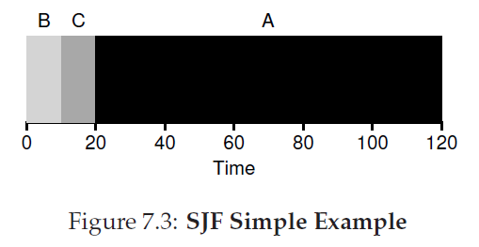
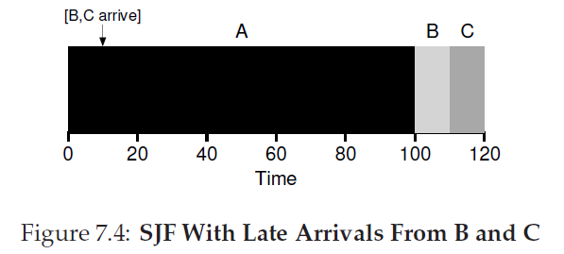
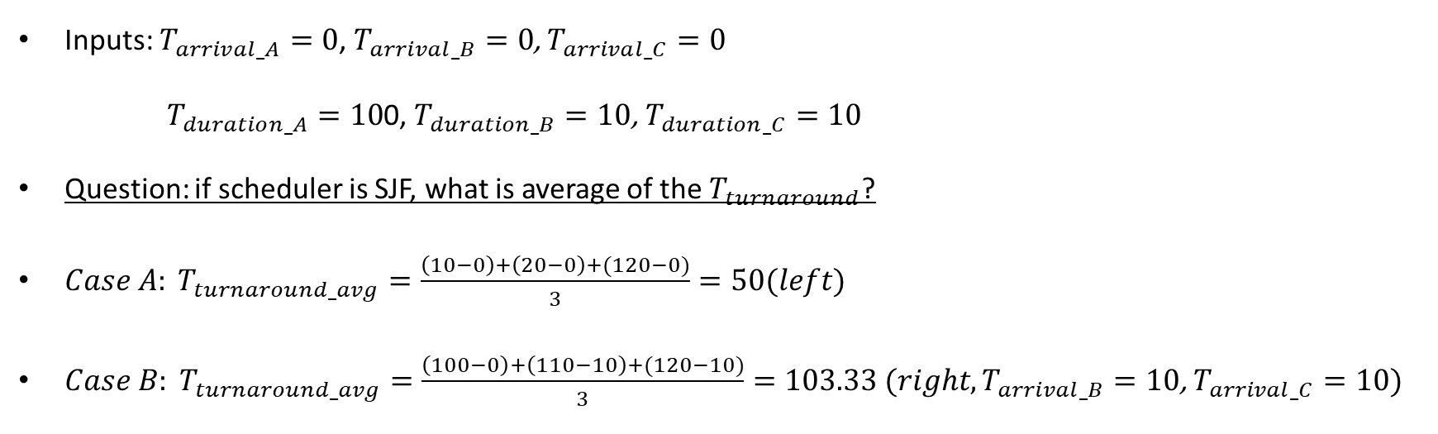
Shortest Job First (SJF)
Inputs: $T_{arrival_A}=0$, $T_{arrival_B}=0$, $T_{arrival_C}=0$
$T_{duration_A}=10$0, $T_{duration_B}=10$, $T_{duration_C}=10$
Question: if scheduler is SJF, what is average of the $T_{turnaround}$?
${Case A: T}_{turnaround_avg}=\frac{\left(10−0\right)+\left(20−0\right)+(120−0)}{3}=50(left)$
${Case B: T}_{turnaround_avg}=\frac{\left(100−0\right)+\left(110−10\right)+(120−10)}{3}=103.33 (right,T_{arrival_B}=10\text{, }T_{arrival_C}=10)$
Case A
Case B

Slide 9
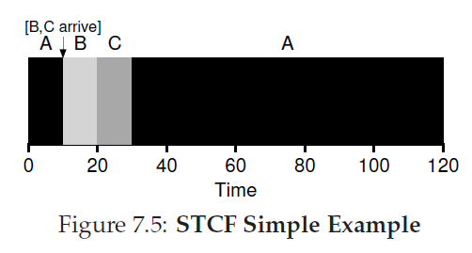
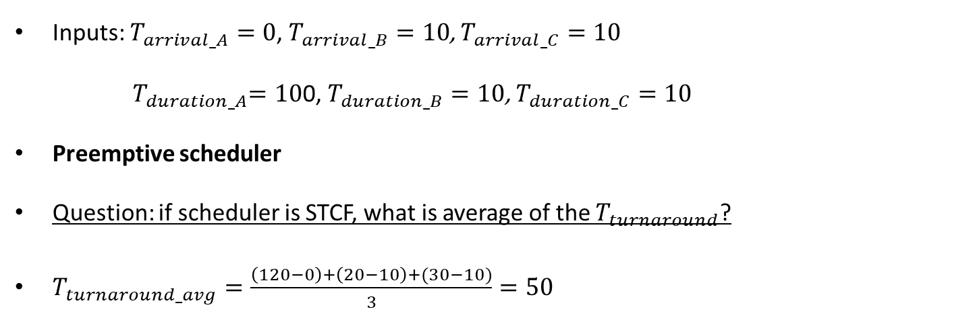
Shortest Time-to-Completion First (STCF)
Inputs: $T_{arrival_A}=0$, $T_{arrival_B}=10$, $T_{arrival_C}=10$
${ T}_{duration_A}=10$0, $T_{duration_B}=10$, $T_{duration_C}=10$
Preemptive scheduler
Question: if scheduler is STCF, what is average of the $T_{turnaround}$?
$T_{turnaround_avg}=\frac{\left(120−0\right)+\left(20−10\right)+(30−10)}{3}=50$

Slide 10
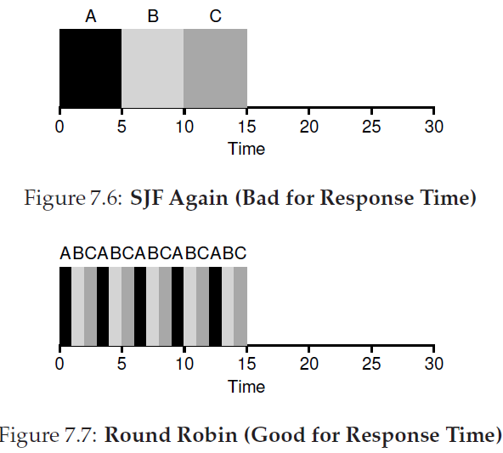
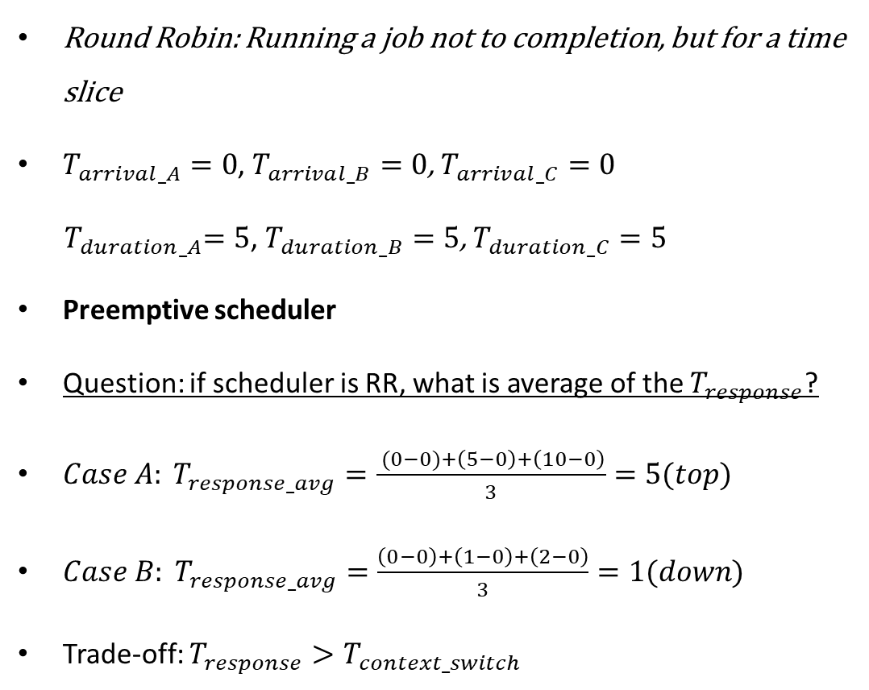
Round Robin (RR)
Round Robin: Running a job not to completion, but for a time slice
$T_{arrival_A}=0$, $T_{arrival_B}=0$, $T_{arrival_C}=0$
${ T}_{duration_A}=5$, $T_{duration_B}=5$, $T_{duration_C}=5$
Preemptive scheduler
Question: if scheduler is RR, what is average of the $T_{response}$?
$Case A: T_{response_avg}=\frac{ (0−0)+\left(5−0\right)+\left(10−0\right)}{3}=5(top)$
$Case B: T_{response_avg}=\frac{\left(0−0\right)+\left(1−0\right)+\left(2−0\right)}{3}=1(down)$
Trade-off: $T_{response}>T_{context_switch}$
Case A
Case B

Slide 11
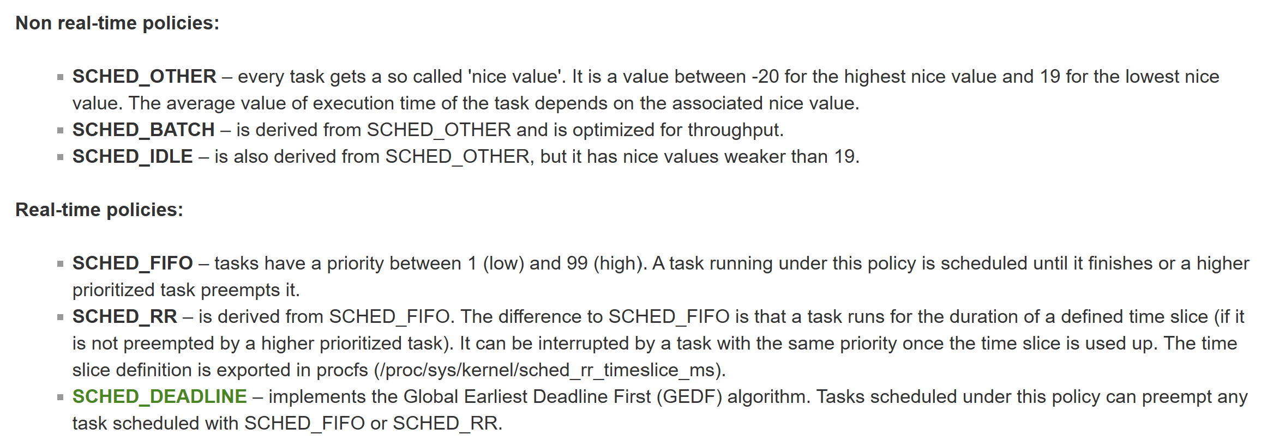
Summary[1]
[1] https://wiki.linuxfoundation.org/realtime/documentation/technical_basics/sched_policy_prio/start

